Slide 1
Tourist Place Recommendation
GROUP-3

Slide 2
MEMBERS
TRAVELLER
Hardik Kathuria 20BAI1048
Devanshu Khemka 20BAI1319
Sarvesh Chandak 20BAI1221
.

Slide 3




WHAT WE ARE WORKING ON
HTML CSS
JAVASCRIPT
PHP & DATABASE

Slide 4
ABOUT THE PROJECT
This project is based on how an effective travel website will make us feel. It is based on a traveling website with fully-featured functions that will activate the traveling bug with vibrant imagery.
This website contains highlights of some important places along with high-quality photography and allows people to book their dream destination within their budgets. It also includes full customer support, vivid options, the customer can choose for there dream destination according to there age and status, also as per there time choice.
We will also try to include the full virtual tour of place through different videos and images.

Slide 5
NOW
HOME PAGE
LOGIN/SIGNUP PAGE
ABOUT US/ CONTACT US
PHP DATABASE
USER INTEREST PAGE

Slide 6
FUTURE
TOURIST PPACES OPTION
WHOLE DATABESE WH
PAYMENT PAGE

Slide 7
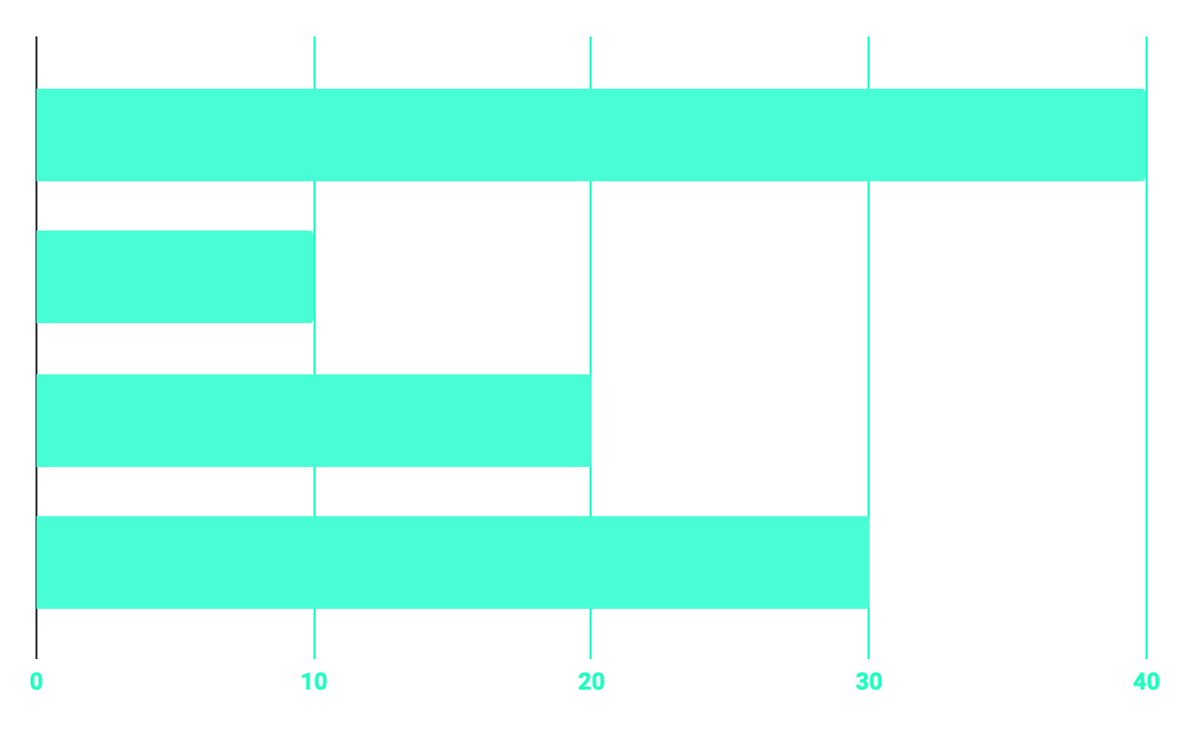
PROGRESS
100%
65%
PROGRAMMING
60%
75%
DATABASE
WEB DESIGN
REVIEW 1

Slide 8
OUR GOALS
Everyone gathers inspirations from different mediums and in different ways. But knowing how to activate those creative juices is an important part of being a creative web designer.
When it comes to travel web design projects, scope can quickly narrow down the resources available. So it becomes difficult to find the right inspiration for travel projects.
This website will help tourist to select place on the basis of their personal interest such as types of activities users want to perform, types of places users want to visit, etc.

Slide 9
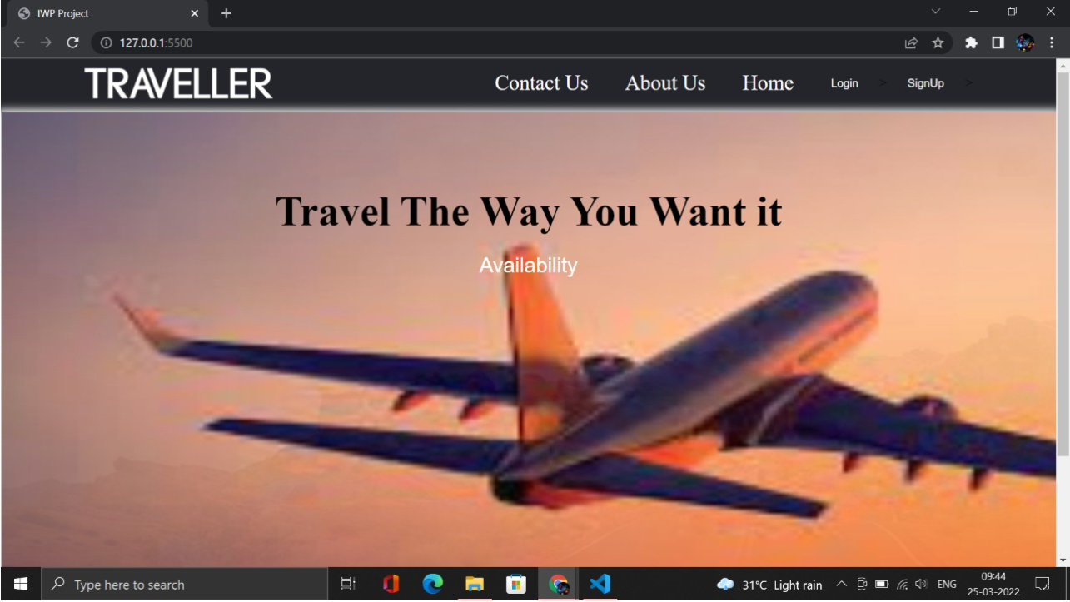
HOME PAGE

Slide 10
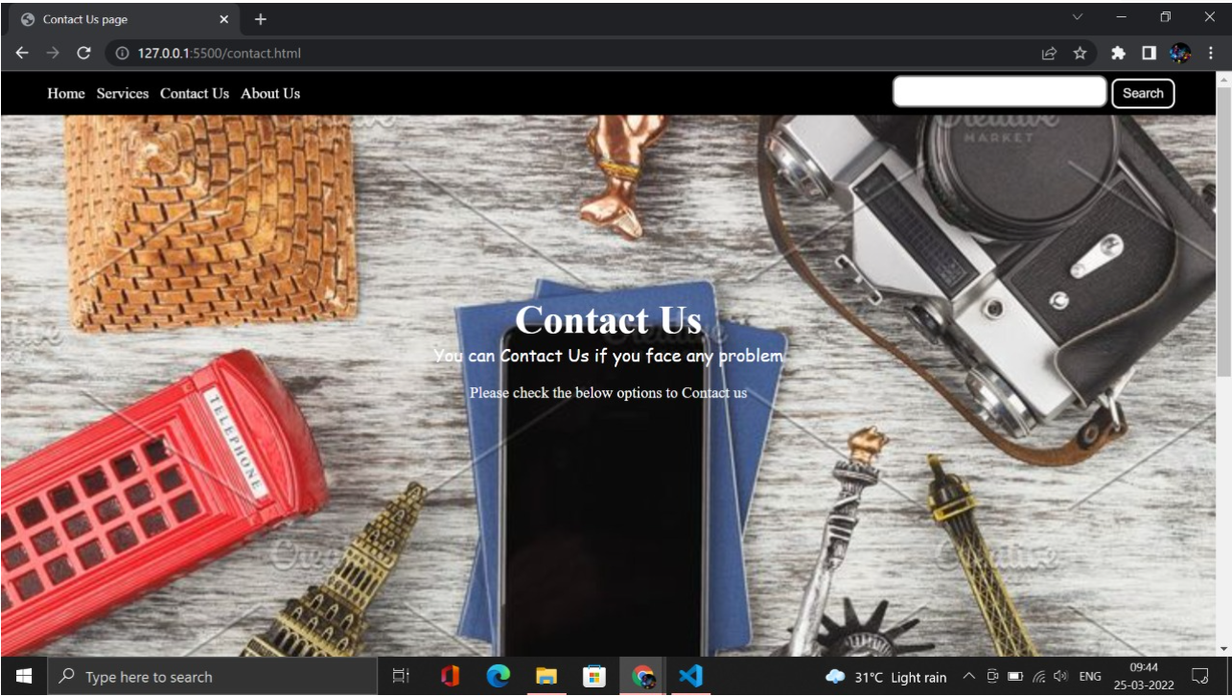
CONTACT US PAGE

Slide 11
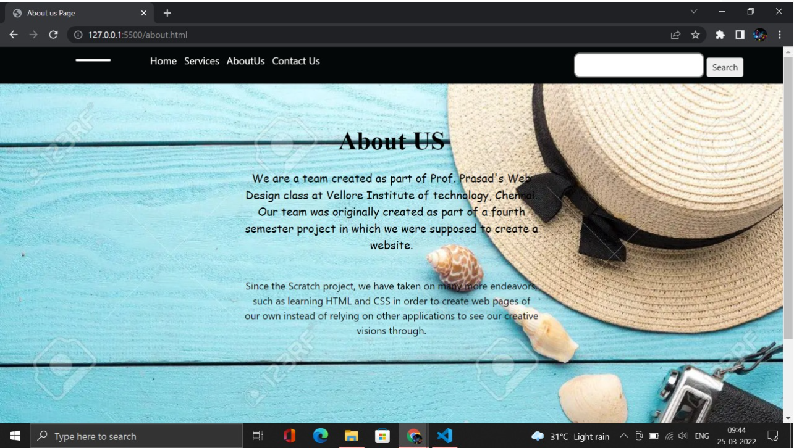
ABOUT US PAGE

Slide 12
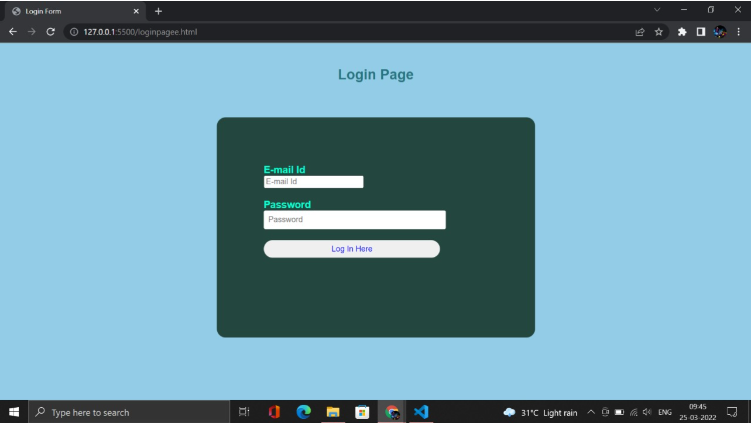
LOGIN PAGE

Slide 13
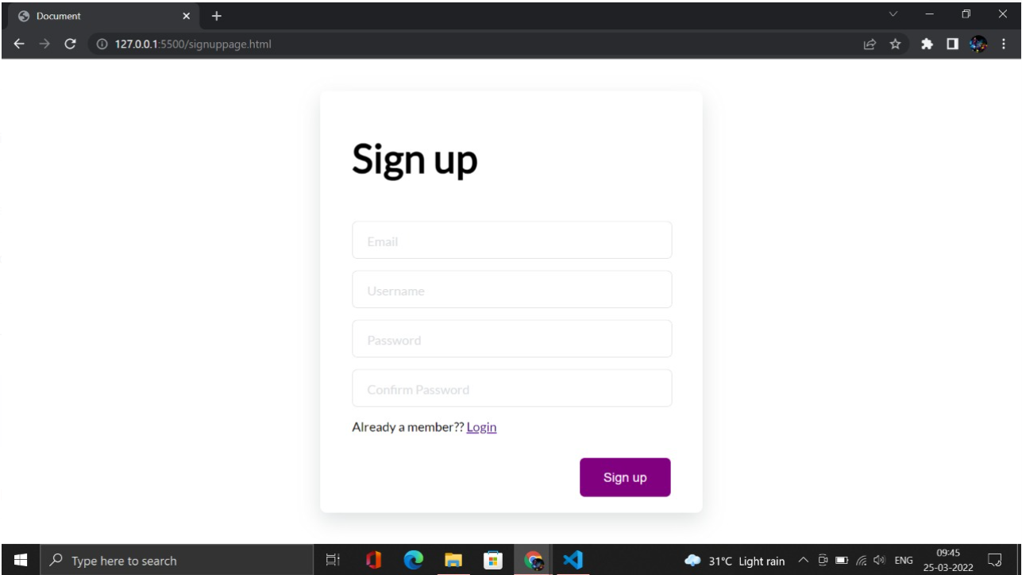
SIGN UP PAGE

Slide 14
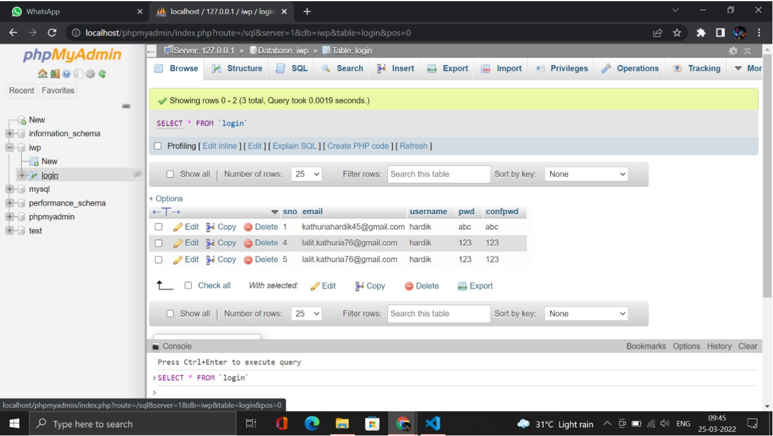
DATABASE

Slide 15
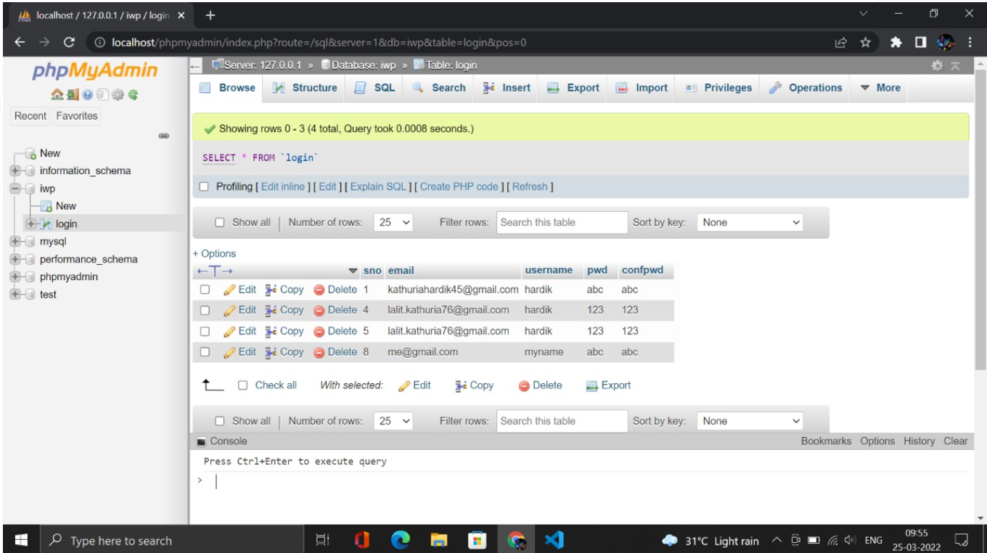
DATABASE

Slide 16
THANKS!
Does anyone have any question?
addyouremail@freepik.com
+ 91 7693891442

Slide 17
CREDITS
This is where you give credit to the ones who are part of this project.
HARDIK KATHURIA
SARVESH CHANDAK
KRISH BAGGA
DEVANSHU KHEMKA

Slide 18
TRAVELLER

